Slide 1

Basic Cryptography
Network and Security (INFO8965)
Pawan Soobhri
MISSM, PGDBM, BTech
Professor
Email: psoobhri @conestogac.on.ca
1

Slide 2
REFERENCES AND ACKNOWLEDGEMENT
References
[CIAM] “CompTIA® Security+ Guide to Network Security Fundamentals” by Mark
Ciampa, 7th edition, Publisher: Cengage Learning
[STAL] “Network Security Essentials,” by William Stallings, 5th edition, Publisher:
Pearson
Acknowledgement
Some of the material presented here is taken from:
The referenced textbook [CIAM] by Cengage Learning.
Other references are cited individually.
ALI HASSAN
2

Slide 3
LECTURE OUTLINE
Cryptography
Hash, symmetric, and asymmetric cryptographic algorithms Different cryptographic attacks
Uses of Cryptography

Slide 4
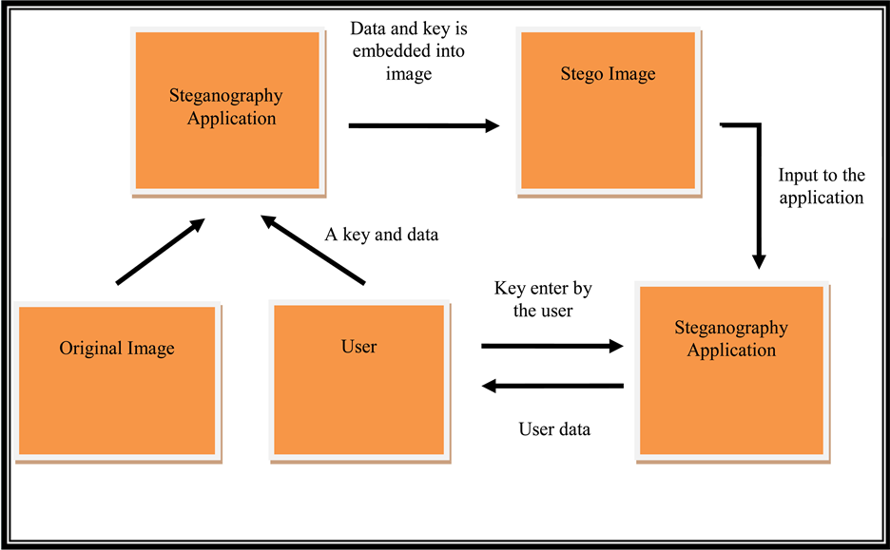
WHAT IS CRYPTOGRAPHY?
Cryptography
the study of secure communications techniques, in the presence of adversarial behavior
Transform information into form that unintended recipients cannot understand
Steganography
This Photo by Unknown Author is licensed under CC BY
Practice of hiding a secret message inside something (e.g., an image file) that is not secret
Achieved by dividing data and hiding in unused portions of the file
May hide data in the file header fields that describe the file, between sections of the metadata (data used to describe the content or structure of the actual data)
  Text steganography, Image steganography, Video steganography, Audio steganography

Slide 5
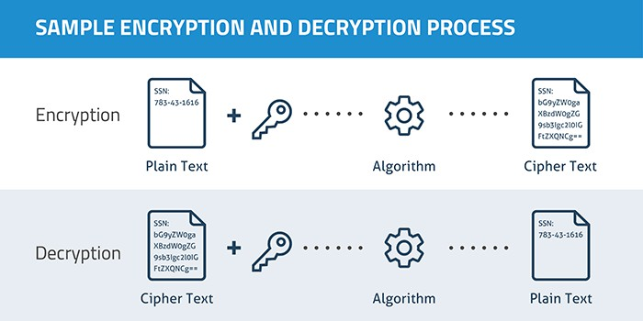
WHAT IS CRYPTOGRAPHY?
Encryption: process that converts plaintext into an unreadable secret message (ciphertext) using cryptography.
Decryption: Reverses the process, turning ciphertext back into plaintext.
  Plaintext: Original data to be encrypted.
  Cipher: Cryptographic algorithm used for encryption and decryption.
  Ciphertext: Encrypted, unreadable output.
This Photo by Munkhzaya Ganbold is licensed under CC BY-SA

Slide 6
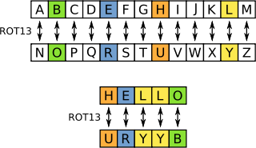
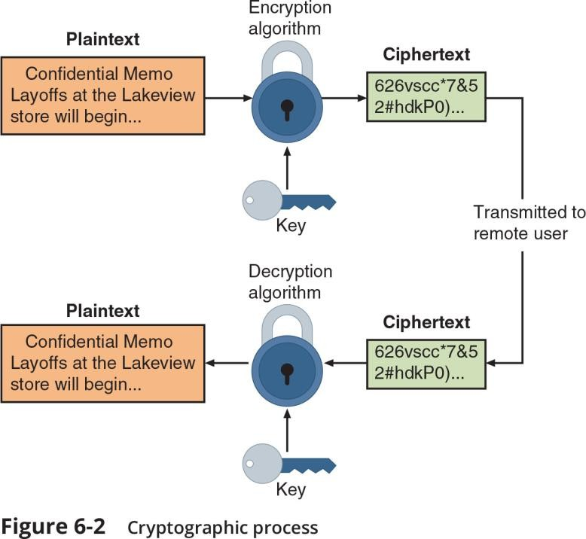
WHAT IS CRYPTOGRAPHY?
A key is a mathematical value entered into the algorithm to produce ciphertext
The reverse process uses the key to decrypt the message
A substitution cipher substitutes one character for another
Simplest type is a ROT13 (rotate by 13), in which the entire alphabet is rotated 13 steps (A=N) and second time gives back the original text.
An XOR cipher is based on the binary operation eXclusive OR
that compares two bits
If the bits are different, a 1 is returned, if they are identical, a 0 is returned
This Photo by Benjamin D. Esham is licensed under CC BY-SA
Mark Ciampa, CompTIA Security+ Guide to Network Security Fundamentals, 7th Edition. © 2022 Cengage. All Rights Reserved. May not be scanned, copied or duplicated, or posted to a publicly accessible website, in whole or in part.
6

Slide 7
WHY USE CRYPTOGRAPHY?
Cryptography can provide several basic protections
Confidentiality ensures only authorized parties can view it
Integrity ensures information is correct and unaltered
Authentication ensures sender can be verified through cryptography
Nonrepudiation proves that a user performed an action For Example: Digital Signature
Obfuscation is making something obscure or unclear
7

Slide 8
Cryptography - Example
Let’s now, perform the reverse using the same key: 00100011
Plain Text ASCII | H | E | L | L | O
Plain Text Binary | 01001000 | 01000101 | 01001100 | 01001100 | 01001111
Key | 00100011 | 00100011 | 00100011 | 00100011 | 00100011
XOR’d Output | 01101011 | 01100110 | 01101111 | 01101111 | 01101100
Encrypted CipherText | k | f | o | o | l
CipherText Binary | 01101011 | 01100110 | 01101111 | 01101111 | 01101100
Key (from above) | 00100011 | 00100011 | 00100011 | 00100011 | 00100011
Plain Text Binary | 01001000 | 01000101 | 01001100 | 01001100 | 01001111
Plain Text ASCII | H | E | L | L | O

Slide 9
LIMITATIONS OF CRYPTOGRAPHY
Cryptographic constraints
  Processing speed - slower speed unacceptable for some applications
  Resulting size of encrypted file
  Weak cryptographic keys
  Key length – short key length results in weaker security
  Reusing encryption key
  Entropy is a measure of the randomness or diversity of a data-generating function. Low entropy increase predictability
9

Slide 10
KNOWLEDGE CHECK
Which of the following is a term that proves that a user performed an action with a computer or on data?
Confidentiality
Nonrepudiation
Obfuscation
Authentication
10

Slide 11
CRYPTOGRAPHIC ALGORITHMS
A fundamental difference in cryptographic algorithms is the amount of data processed at a time
Stream cipher - takes one character and replaces it with another, RC4
Block cipher - manipulates an entire block of plaintext at one time, AES
Sponge function - takes as input a string of any length and returns a string of any requested variable length, SHA-256 (SHA3)
Three categories of cryptographic algorithms
Hash algorithms
Symmetric cryptographic algorithms
Asymmetric cryptographic algorithms
11

Slide 12
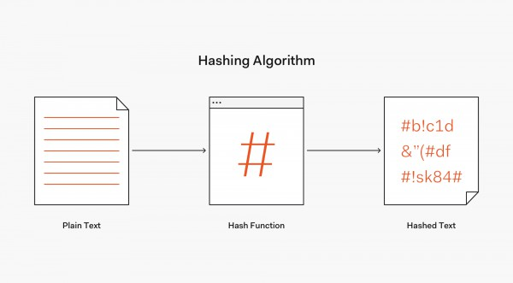
HASH ALGORITHMS
Hash algorithm creates a unique “digital fingerprint” (called message digest or hash) of a set of data – often used to verify that original contents are not changed.
Secure hashing algorithm characteristics:
Fixed size - short and long data sets have the same size hash
Unique - two different data sets cannot produce the same hash
One-way – digest/hash cannot be reversed to reveal original data set
Common Hashing Algorithms:
MD5 (Message Digest 5), SHA-1, SHA-256, SHA3
This Photo by Unknown Author is licensed under CC BY-SA-NC
12

Slide 13
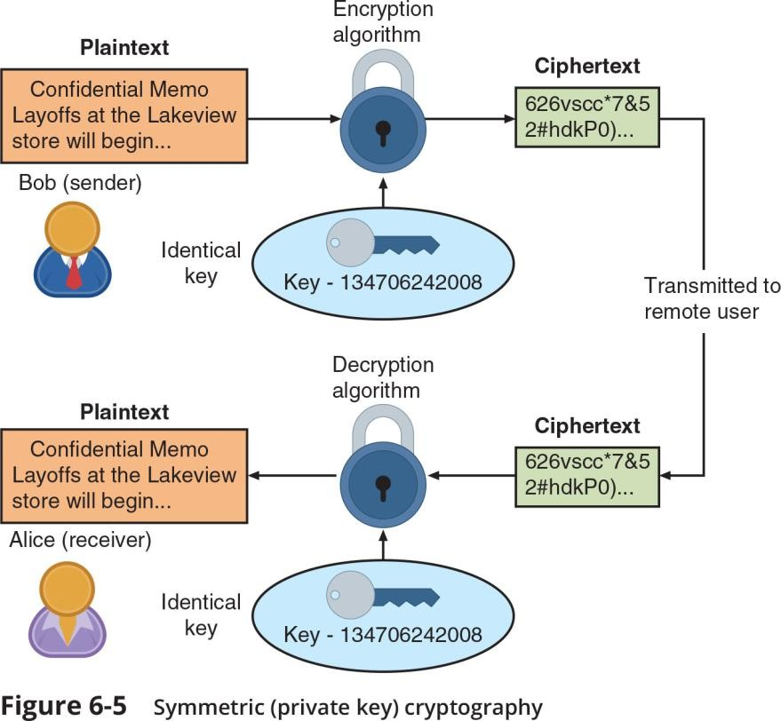
SYMMETRIC CRYPTOGRAPHIC ALGORITHMS
Symmetric cryptographic algorithms use the same single
key to encrypt and decrypt a document
Also called private key cryptography (the key is kept private between sender and receiver)
Common algorithms include:
Data Encryption Standard (DES)
Triple Data Encryption Standard (3DES)
Advanced Encryption Standard (AES)
Rivest Cipher (RC)
Blowfish
Mark Ciampa, CompTIA Security+ Guide to Network Security Fundamentals, 7th Edition. © 2022 Cengage. All Rights Reserved. May not be scanned, copied or duplicated, or posted to a publicly accessible website, in whole or in part.
13

Slide 14
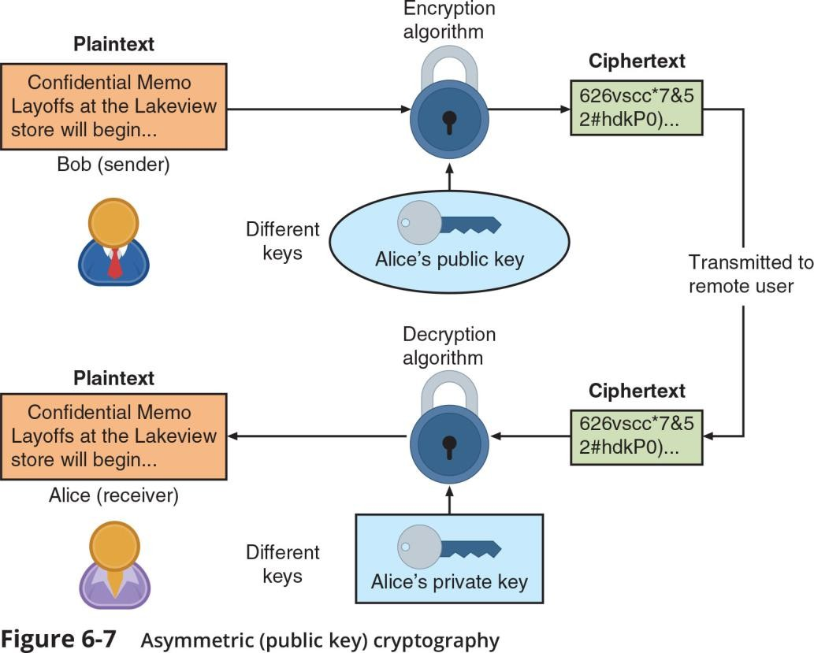
ASYMMETRIC CRYPTOGRAPHIC ALGORITHMS
Primary weakness of symmetric algorithms: distributing and maintaining a secure single key among multiple users distributed geographically
Asymmetric cryptographic algorithms use two mathematically related keys
  Also known as public key cryptography
  Public key available to everyone and freely distributed
  Private key known only to individual to whom it belongs
Important principles
Key pairs - Public key and Private key
Both directions - keys can work in both directions
Mark Ciampa, CompTIA Security+ Guide to Network Security Fundamentals, 7th Edition. © 2022 Cengage. All Rights Reserved. May not be scanned, copied or duplicated, or posted to a publicly accessible website, in whole or in part.

Slide 15
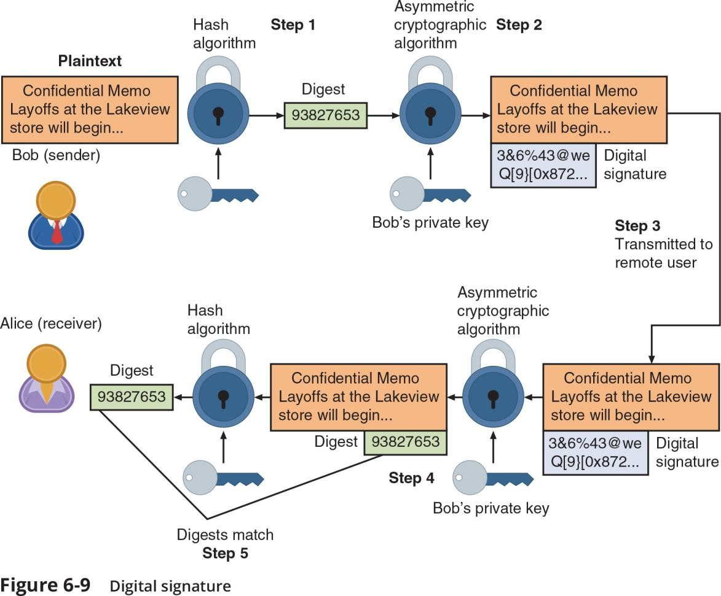
ASYMMETRIC CRYPTOGRAPHIC ALGORITHMS
Digital Signature Algorithm (DSA)
Creates a digital signature - an electronic verification of the sender
A digital signature can:
            Verify the sender
            Prevent sender from disowning the message –nonrepudiation
            Prove message integrity
Bob’s public key
Mark Ciampa, CompTIA Security+ Guide to Network Security Fundamentals, 7th Edition. © 2022 Cengage. All Rights Reserved. May not be scanned, copied or duplicated, or posted to a publicly accessible website, in whole or in part.

Slide 16
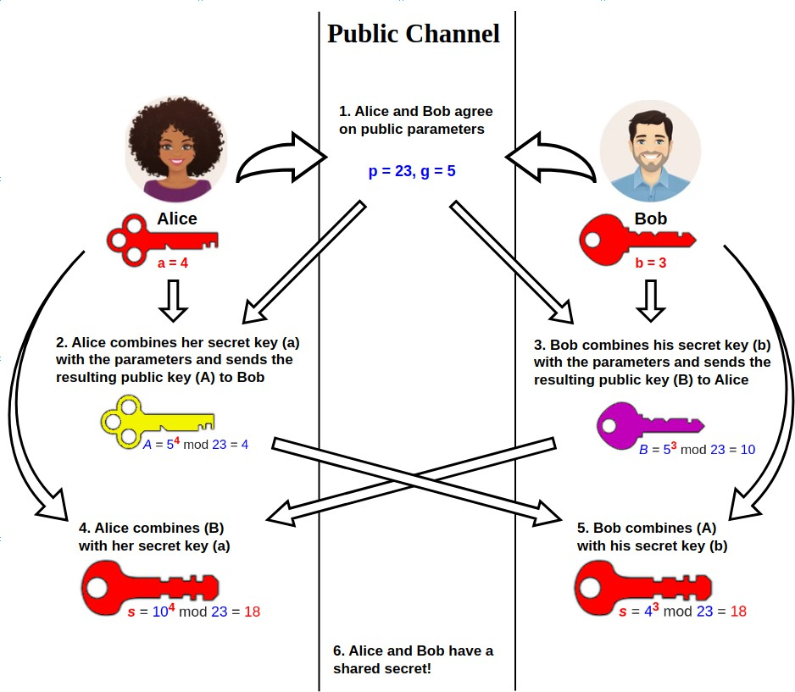
ASYMMETRIC CRYPTOGRAPHIC ALGORITHMS
Key Exchange - Method in cryptography by which parties exchange cryptographic keys to be used for communication.
Out-of-band – Using another means of communication than the one used to exchange ciphertexts.
There are different solutions for a key exchange that occurs within the normal communications channel (in-band) of cryptography
Diffie-Hellman (DH), Diffie-Hellman Ephemeral (DHE), Elliptic Curve Diffie-Hellman (ECDH), Perfect forward secrecy
This Photo by Epachamo is licensed under CC BY-SA 4.0

Slide 17

Encrypt message using conventional encryption with symmetric-key
Encrypt the symmetric key using recipient's public key
Attach encrypted key to encrypted message and send to
recipient

Slide 18
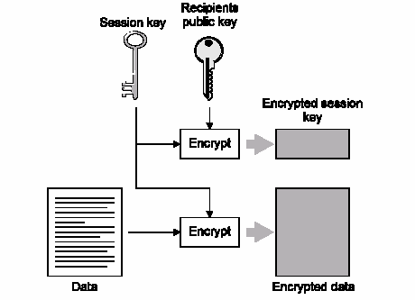
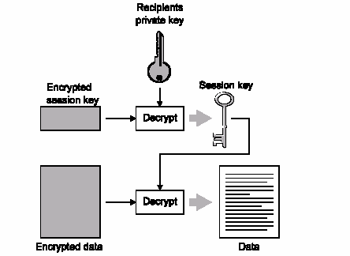
Combine Asymmetric and Symmetric - Hybrid
After the message is sent, the session key is discarded and not reused.

Slide 19
USING CRYPTOGRAPHY - ENCRYPTION THROUGH SOFTWARE
File and File System Cryptography
Encryption software can be used to encrypt or decrypt files one-by-one (a cumbersome process)
Protecting groups of files can take advantage of the OS’s file system
Third-party software tools available for encryption include GNU Privacy Guard (GNuPG)- encrypts files and emails, AxCrypt, Folder Lock, and VeraCrypt
Operating System Encryption
🢝 Microsoft Windows Encrypting File System (EFS) is a cryptography system for Windows
🢝 EFS uses NTFS file system
🢝 Tightly integrated with the file system
🢝 Encryption and decryption are transparent to the user

Slide 20
USING CRYPTOGRAPHY - ENCRYPTION THROUGH SOFTWARE
Full Disk Encryption (FDE)
FDE protects all data on a hard drive
Example: BitLocker drive encryption software that is included in Microsoft Windows
BitLocker encrypts the entire system volume, including the Windows Registry
Prevents attackers from accessing data by booting from another OS or placing the hard drive in another computer

Slide 21
USING CRYPTOGRAPHY - HARDWARE ENCRYPTION
Software encryption can be subject to attacks to exploit its vulnerabilities Cryptography can be embedded in hardware
Provides higher degree of security
Can be applied to USB devices and standard hard drives
HELLO -> HASH -> qwertyuiop
Salt A#B$C:
A#B$CHELLO -> HASH -> pojhystrr

Slide 22
USING CRYPTOGRAPHY - HARDWARE ENCRYPTION
USB device encryption
Encrypted hardware-based flash drives can be used
🢝 Will not connect a computer until correct password has been provided
🢝 All data copied to the drive is automatically encrypted
🢝 Tamper-resistant external cases
🢝 Administrators can remotely control and track activity on the devices
🢝 Stolen drives can be remotely disabled
Self-Encrypting Drives (SEDs)
Self-encrypting hard disk drives protect all files stored on them
The drive and host device perform authentication process during initial power up
If authentication fails, the drive can be configured to deny access or even delete encryption keys, so all data is permanently unreadable

Slide 23

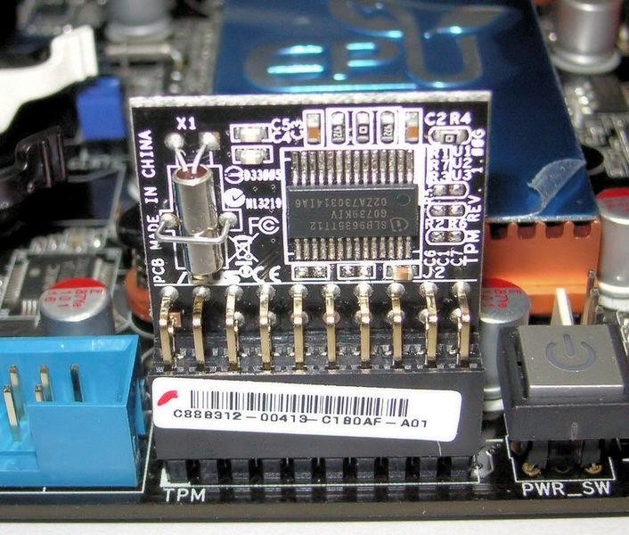
USING CRYPTOGRAPHY - HARDWARE ENCRYPTION
Hardware Security Module (HSM)
HSM is a removable external cryptographic device
It includes an onboard key generator and key storage facility –
Malware cannot compromise it
Performs accelerated symmetric and asymmetric encryption
Trusted Platform Module (TPM)
TPM is a chip on a computer’s motherboard that provides cryptographic services
Includes a true random number generator
Entirely done in hardware so it cannot be subject to software attack
Prevents computer from booting if files or data have been altered
Prompts for password if hard drive moved to a new computer
This Photo by Alexander Klink is licensed under CC BY 3.0
24
This Photo by Unknown Author is licensed under CC BY-SA

Slide 24
Questions?
25

